Slide 1
AMERICAN IRON WORKS INC. 4000 S Czech Hall Rd Yukon, OK 73099 405-577-2877 HOSE HOBBLE SIZING & PLACEMENT INSTRUCTIONS.
A high-pressure top-drive rotary hose ruptured under a pressure of 3000 psi. The hose fell to the rig floor and knocked down a roughneck. He was not seriously hurt, although the incident could have been potentially serious. WHAT CAUSED IT: The hose was rated for 5000 psi working pressure. An investigation following the incident revealed that the restraining safety clamps were not correctly placed around the yellow marker bands marked “Safety Clamp Here”. Instead, the clamps were placed closer to the crimped union where the diameter of the hose is larger. In this case the hose ruptured when it blew out of the end ferrule. As the safety clamp was in the wrong position, it did not properly restrain the hose, which passed completely through it. In addition, it was found that the safety clamps were too large to grip the smaller diameter of the hose below the ferrule.
IT IS THE SOLE RESPONSIBILITY OF THE END USER TO INSURE PROPER SIZING & PLACEMENT OF HOBBLE SYSTEMS.

Slide 2
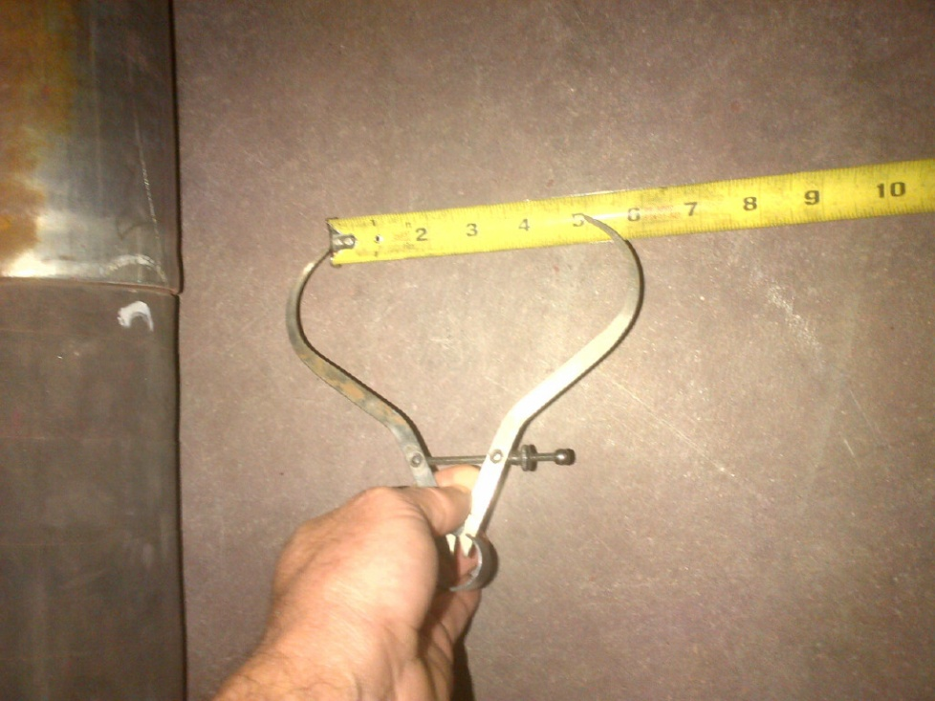
Step 1-Measure the diameter of the hose.

Slide 3
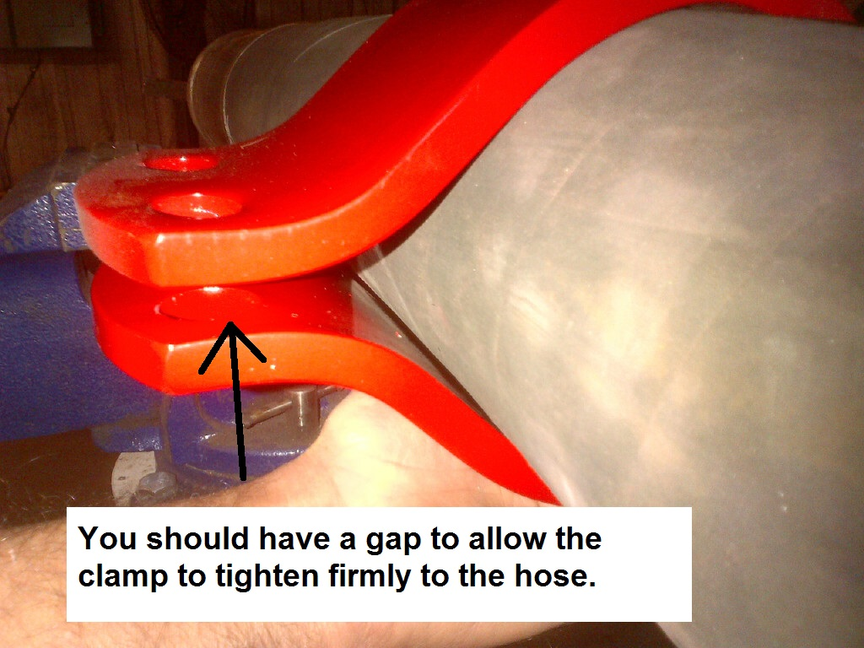
Step 2-Make sure the Hobble Clamp is the proper size.

Slide 4
Step 3-Find proper area on hose to install Hobble Clamp. The hose should be marked approximately 12” from the crimped fitting.

Slide 5
Step 4-Install Hobble Clamp, torque the bolts to approximately 60 foot pounds until clamp is firmly attached to hose.

Slide 6
Step 5-Attach cable or chain to the Hobble Clamp, then attach other end of the cable or chain to a suitable anchoring point.

Slide 7
Failure to follow these instructions can lead to death or serious injury. Please feel free to call 24-7 about any concerns or question regarding these procedures. Steve Beeson, AIW 405-577-2877

